Slide 1
Batch Number: CSE_142 Application Development for monitoring of wool from Farm to fabric
CSE7101- Capstone Project
Review-5
Under the Supervision of,
Dr.T Ramesh
Assistant Professor
School of Computer Science and Engineering
Presidency University
Roll Number | Student Name
20221CSE0600 | Manjunatha
20221CSE0599 | Mamatha S M
20221CSE0569 | Archana P
Name of the Program: B.Tech Computer Science And Engineering
Name of the HoD: Dr. Asif Mohammed
Name of the Program Project Coordinator: Dr. Jayavadivel Ravi
Name of the School Project Coordinators: Dr. Sampath A K , Dr. Geetha A

Slide 2
Problem Statement Number: PSCS_21
Organization: Ministry of Textiles
Category (Hardware / Software / Both) : Software
Problem Description:
An App-based solution for the wool sector in India which can have the following features is required:
1. Wool Market Information: Provide real-time market information on wool prices, trends, and news.
2. Wool Tracking: Allows users to track the production and transport of their wool from farm to market.
3. Quality Assurance: Provides a platform for wool producers to ensure the quality of their wool and access to wool grading services.
4. Wool Storage and Warehousing: Helps farmers store and manage their wool inventory.
5. Wool Processing: Helps farmers access wool processing services such as shearing, sorting and dyeing
6. Wool Trading Platform: Allows wool producers to buy and sell wool directly from other farmers or buyers.
7. Online Wool Marketplace: Provides a platform for wool producers to sell their wool directly to buyers
8. Wool Education and Training: Provides a list of wool producers/artisans region-wise, and state-wise data to provide educational resources and training to help them improve their production, quality, design and marketing skills.

Slide 3
Abstract
The “Farm to Fabric: Wool Monitoring Application” is an innovative digital solution that enables complete transparency and traceability in the wool supply chain.
It connects farmers, processors, manufacturers, and retailers on a single platform to monitor each stage — from wool collection to final fabric production.
The system assigns unique batch IDs to track wool movement and ensure quality verification in real time.
Developed with a modular architecture using modern web technologies, it ensures secure data flow and role-based access.
By reducing manual errors and improving accountability, the application promotes sustainable and efficient supply chain management.
It also supports UN SDG 9 and SDG 12 by fostering responsible production and industrial innovation.

Slide 4
Objectives
To design and develop a digital platform that monitors and manages the entire wool supply chain from farms to fabric production.
To ensure transparency and traceability by recording every stage of the wool lifecycle with real-time updates and status tracking.
To provide role-based access for different stakeholders such as farmers, processors, manufacturers, retailers, and consumers for secure and efficient interaction.
To promote sustainable and responsible production practices aligning with UN SDG 9 (Industry, Innovation & Infrastructure) and SDG 12 (Responsible Consumption & Production).
To build a scalable and user-friendly application that can be extended for other textile supply chains or integrated with technologies like IoT and Blockchain in the future.

Slide 5
Literature Survey Overview
A comprehensive review of 15 key research papers from IEEE, Scopus, and Web of Science was conducted. The review focused on IoT, blockchain, mobile applications, and supply chain digitization relevant to wool and textile industries. This helped identify technological trends, gaps, and informed the design of an integrated wool monitoring application suited for the Indian context.
Literature Review Summary
Paper | Research Domain | Approach | Research Gap | Wool Relevance
P01 | IoT in Wool Monitoring | IoT sensors, blockchain, ML | Lack of real implementation | High
P02 | Web-based Wool SCM | React, Flask, MySQL web app | No mobile app, limited analytics | High
P03 | Blockchain & IoT SCM | Literature review | No wool-specific apps | Medium

Slide 6
Key Findings & Research Gaps
Traditional wool supply chains still depend on manual tracking and poor data flow, leading to inefficiencies and lack of transparency.
The Farm to Fabric system improves traceability, accountability, and secure communication across all stages of production.
Its modular, role-based structure ensures data integrity and supports sustainable practices (UN SDG 9 & SDG 12).
Research gaps exist in the integration of Blockchain, and AI for real-time monitoring and predictive analytics.
Future work should focus on automation, interoperability, and smart sensor integration for achieving a fully transparent and sustainable supply chain.

Slide 7
Existing Methods and Drawbacks
Fragmented traditional wool operations: manual tracking, disparate services
Existing digital solutions focus on other textiles or agriculture, not specifically wool
Lack of real-time monitoring and quality assurance integrated with marketplaces
Limited farmer engagement and education tools
High costs and complexity hinder adoption of blockchain and IoT in wool

Slide 8
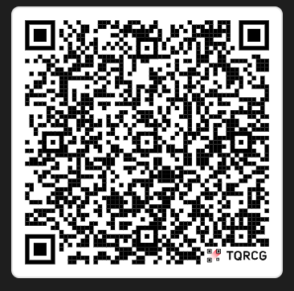
Github Link
https://github.com/Manjunatha-9611/CSE_142__PSCS_21-Application-Development-for-monitoring-of-wool-from-Farm-to-fabric

Slide 9
Proposed Method & Feasibility Study
Our solution proposes a unified web-based platform integrating:
Real-time wool production tracking (farm to market)
Market analytics dashboard for price and demand trends
Quality assurance and grading module using standardized metrics
Additional
Digital inventory and warehousing management
Integrated wool trading marketplace
Educational and training content for skill enhancement
Feasibility: Uses open-source technologies (Node.js, MongoDB, Express.js), supported by cloud hosting (Render/Vercel), scalable architecture, and optional IoT sensor integration for enhanced monitoring.

Slide 10
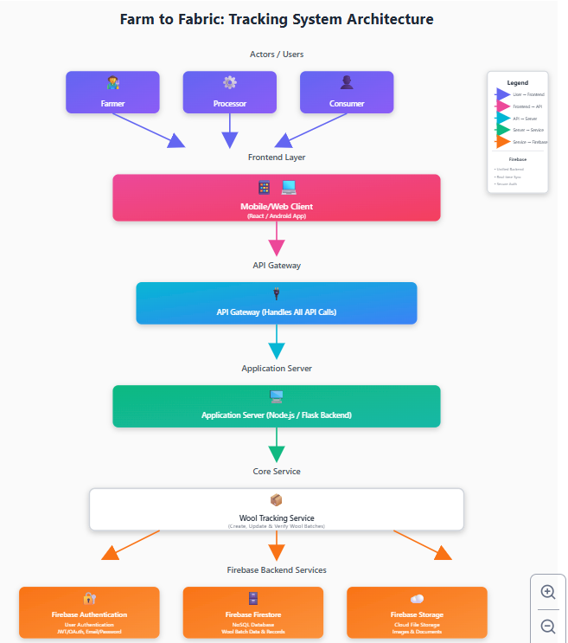
Architecture Diagram
User modules (Farmers, Buyers, Inspectors)
Web application frontend & backend
Database for wool data and transactions
Optional IoT sensor integration for real-time monitoring
Blockchain layer for traceability and data security
APIs connecting different system components

Slide 11
Modules
Market Information Module: Real-time price updates, trends, news
Wool Tracking Module: End-to-end tracking and transport monitoring
Quality Assurance Module: Grading, certification, and inspection workflows
Trading Marketplace: Direct buy/sell interface for producers and buyers
Additional
Storage & Inventory Module: Manage wool stock digitally
Education & Training Module: Tutorials, best practices, regional content

Slide 12
Feasibility & Justification
Open-source stack reduces cost and ensures community support
Cloud deployment ensures scalability and availability
Modular architecture allows incremental development and future IoT integration
Indian wool sector requirements are addressed: local languages, farmer accessibility, scalable marketplace
Extensive literature shows potential but existing gap in end-to-end unified tool

Slide 13
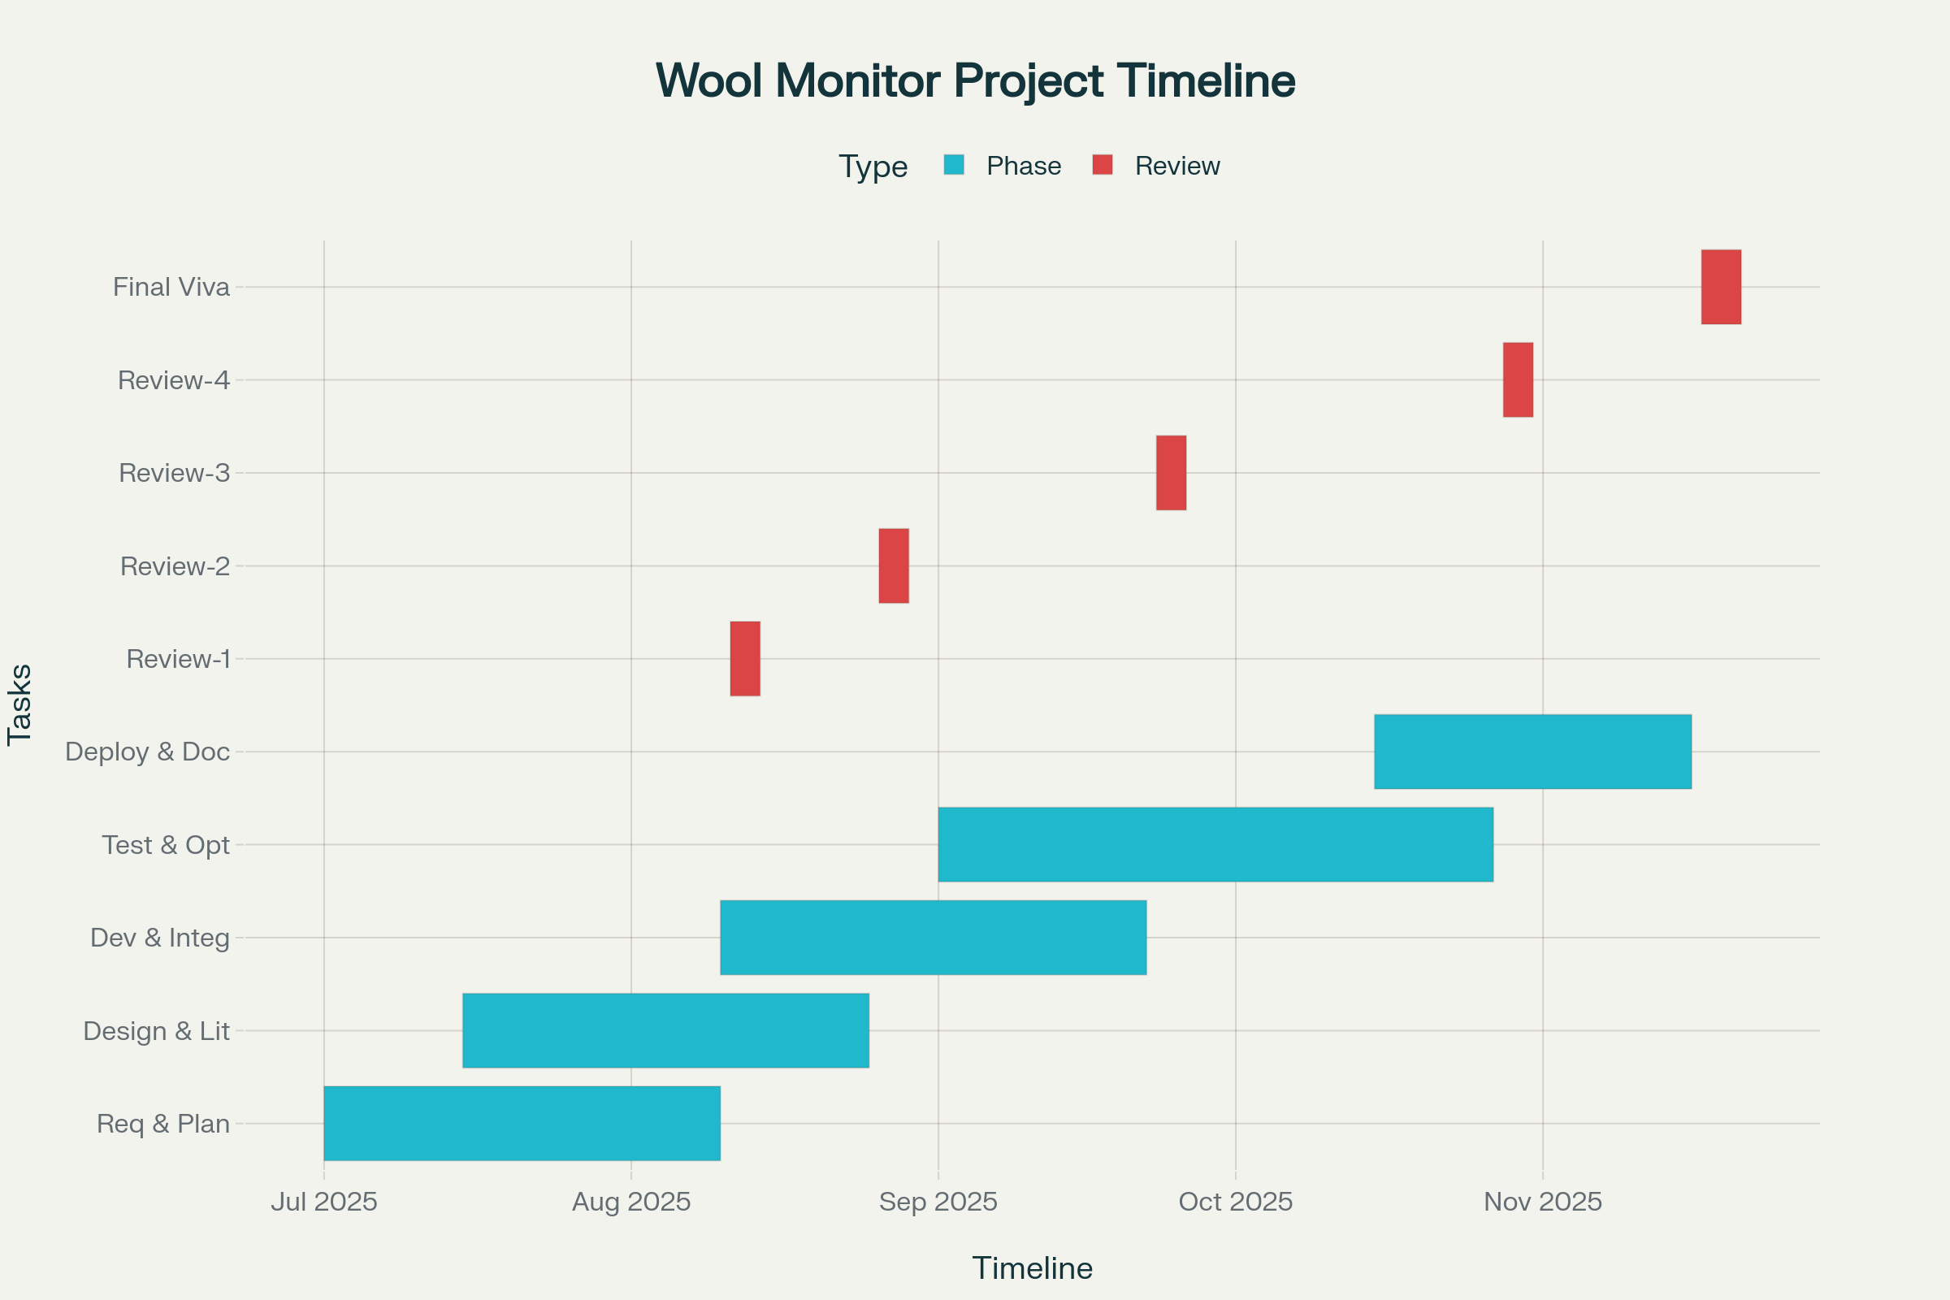
Timeline of the Project (Gantt Chart)

Slide 14
Challenges & Expected Impact
Challenges: Integration complexity, digital literacy among farmers, IoT deployment
Impact: Improved transparency, price discovery, quality assurance, market access, and farmer livelihoods enhancement

Slide 15
References
R. Kumar, S. Patel, and M. Sharma, “IoT-enabled supply chain management system for agriculture produce,” IEEE Access, vol. 11, pp. 34567–34578, May 2023.
S. Banerjee and P. Singh, “Blockchain-based traceability framework for textile industry,” Proc. 2022 Int. Conf. on Emerging Trends in Smart Technologies, pp. 102–108, IEEE, 2022.
“Application Development for Monitoring of Wool from Farm to Fabric,” Int. J. Res. Publication and Reviews, vol. 5, no. 6, pp. 3273–3278, June 2024.
“Web Based Monitoring of Wool from Farm to Fabric,” Int. J. Res. Publication and Reviews, vol. 5, no. 11, pp. 2012–2017, Nov 2024.
H. M. Dawood, C. Bai, S. I. Zaman, M. Quayson and C. Garcia, "Enabling the Integration of Industry 4.0 and Sustainable Supply Chain Management in the Textile Industry: A Framework and Evaluation Approach," IEEE Transactions on Engineering Management, vol. 71, pp. 14704-14717, Sept 2024.

Slide 16


